Slide 1
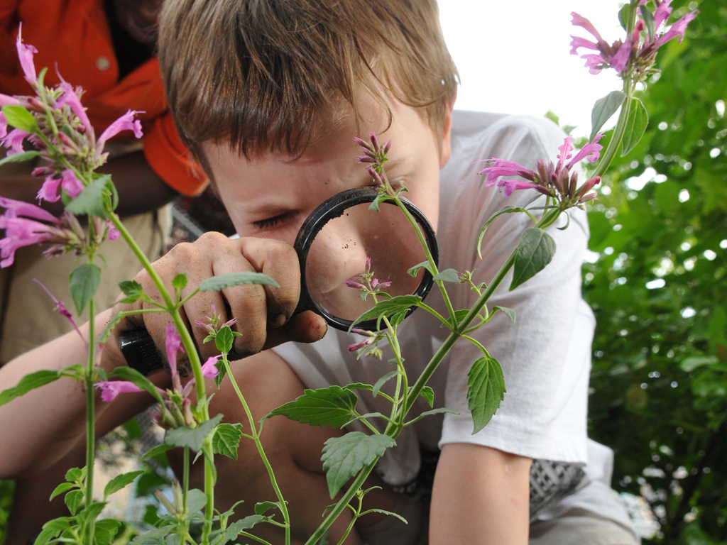
Ecosystem Cultivators Convening
November 4, 2014
Thanks to the Noyce Foundation
Samueli Foundation
Schusterman Foundation and STEM Funders Network

Slide 2
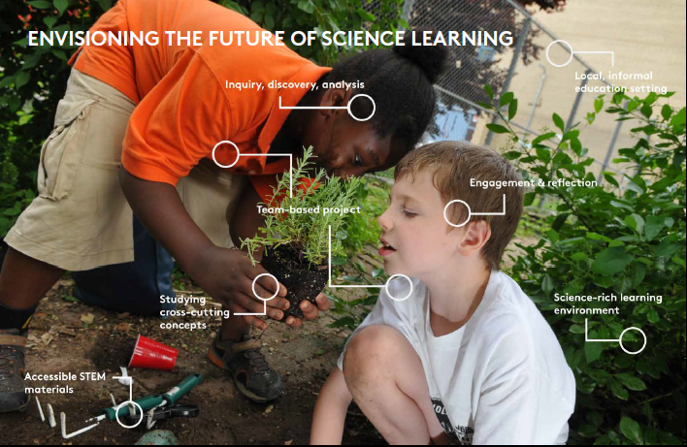

Slide 3
Agenda
8:20 a.m. Welcome and Overview
8:30 a.m. Why Cultivate STEM Ecosystems?
8:45 a.m. Ecosystem Team Activity
9:30 a.m. Break
9:45 a.m. Learning Rounds
11:10 a.m. Break
11:20 a.m. Thorny Issues Panel 1: Data, Assessment and Evaluation
12:30 p.m. Networking Luncheon
1:10 p.m. Sector-Based Working Groups
2:20 p.m. Thorny Issues Panel 2: Scale, Depth and Sustainability
3:40 p.m. End of Day Reflection Exercise & Closing Remarks
4:00 p.m. Meeting Adjourns

Slide 4
Desired outcomes
Identify innovative strategies and resources that will shape the practitioners’ guide
Give you all a chance to meet and learn from each other
Raise thorny issues and generate ideas for addressing them
Success is everyone leaving with an idea from someone else here to cultivate a stronger, better ecosystem in your own community.

Slide 5
Rules of engagement
Be Open Minded & Learn
Be Present
Questions on Cards – Clarification
Step Up, Step Back
Advocate vs. Inquire
Be Candid
Don’t use your Acronyms

Slide 6
STEM Funders Network (SFN)
STEM Ecosystem Cultivator Convening
Why Cultivate STEM Ecosystems?
November 3 – 4, 2014
Chicago O’Hare Marriott
Jan Morrison
President and CEO TIES
Director of Staff, SFN

Slide 7

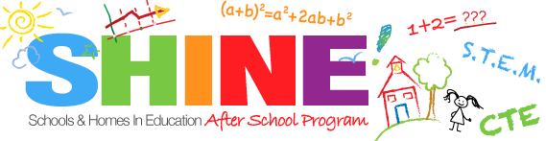

STEM is Everywhere
Notes:
STEM Learning is not restricted to school OR after but is found Everywhere. We need to provide interconnected learning platforms to align and optimize STEM opportunities.

Slide 8

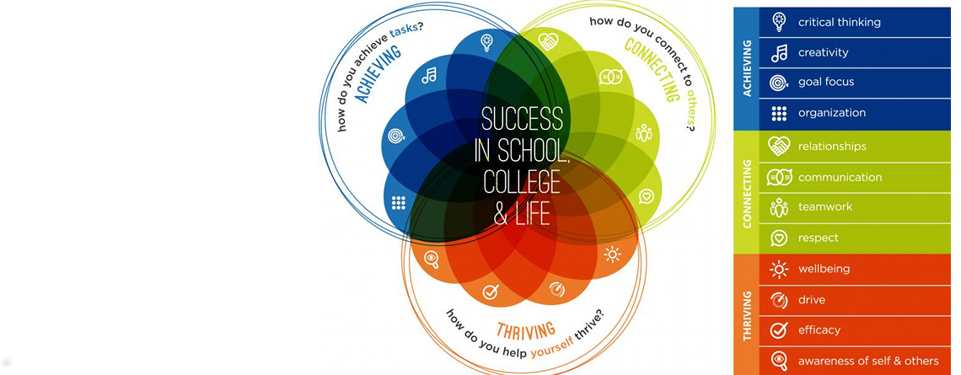
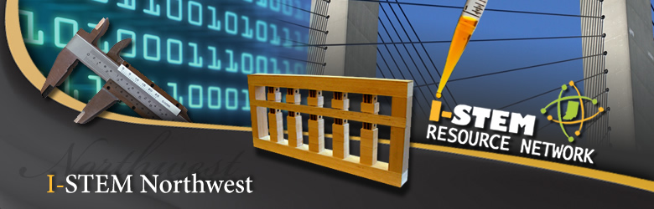
Collaboration is the fuel for Ecosystems
Being connected is far superior to not being connected!!
Notes:
Collaboration among disparate systems that touch the same user is vital. Our children are navigating multiple systems that claim the same successes. We know that this is not true and we know that collaboration is not a natural act, enlightened self-interest is. Therefore we need to move our siloed systems and combine assets, processes and opportunities into what will be an authentic STEM Ecosystem. We know that being connected is far superior to not being connected.

Slide 9
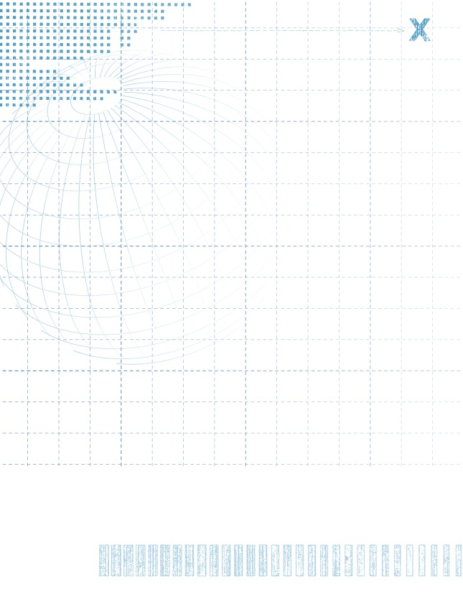
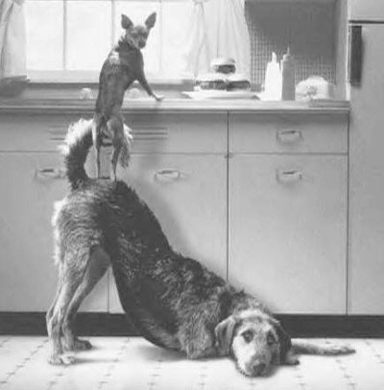
Collaboration is not a natural act.
.
Collaboration is not a natural act…
Enlightened self-interest is!!

Slide 10
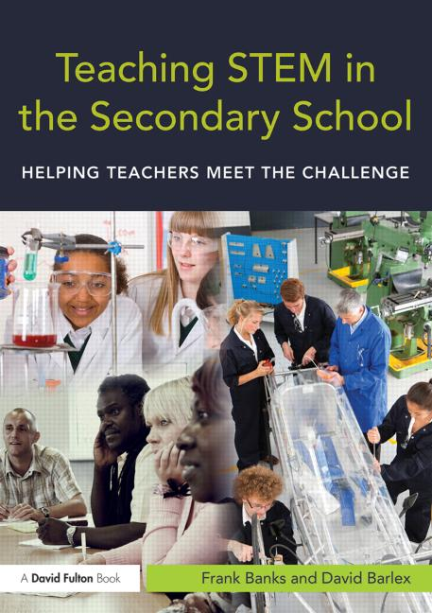

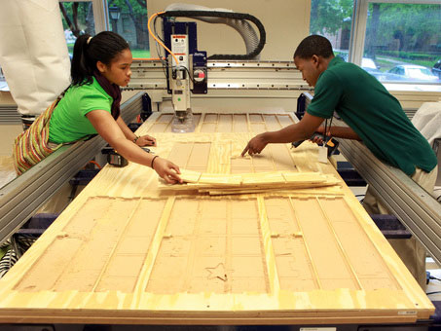
STEM Ecosystems WORK
STEM education is not the complete story. Any worthy STEM education system/program should be aligned with the world of work and its demands for competencies and skills.
We want our children to LOVE all things STEM but we want them ready for a world of great professions and experiences.
We want them able to code, to put on a hard hat, to teach in a STEM classroom. This requires an elegant STEM Ecosystem that supports this aspiration for all children.
Notes:
STEM education is not the complete story. Any worthy STEM education system/program should be aligned with the world of work and its demands for competencies and skills. We want our children to LOVE all things STEM but we want them ready for a world of great professions and experiences. We want them able to code, to put on a hard hat, to teach in a STEM classroom. This requires an elegant STEM Ecosystem that supports this aspiration for all children.

Slide 11
STEM ECOSYSTEMS
SUMMER PROGRAMS
AFTER SCHOOL PROGRAMS
PK-12 PUBLIC AND CHARTER SCHOOLS
MUSEUMS AND SCIENCE CENTERS
INFORMAL STEM AT HOME
POST-SECONDARY
FAB LABS
FOUNDATIONS AND NON-PROFITS
STEM BUSINESS/INDUSTRY
A learning ecosystem harnesses the unique contributions of all these different settings to deliver STEM learning for all children
Notes:
11
Children come to their own lives with a variety of learning styles and constraints. Meeting their needs and providing a quality and sustained STEM education means that the nature of the education has to have multiple modalities of engagement.
Fab Labs, Museum design squads, 4H robotics and many more in the out of school space are now helping schools to understand what is possible for all students. You are all the evidence of the emergence of this kind of collaboration/ecosystem.

Slide 12
THE STEM ECOSYSTEM PROMISE
It is our role today to begin to ensure the kind of collective impact for our country’s youngsters that ONLY strong and vital system of collaborators can provide.
The STEM Ecosystem seems to be the proper paradigm to design and build out for our communities—it works!

Slide 13
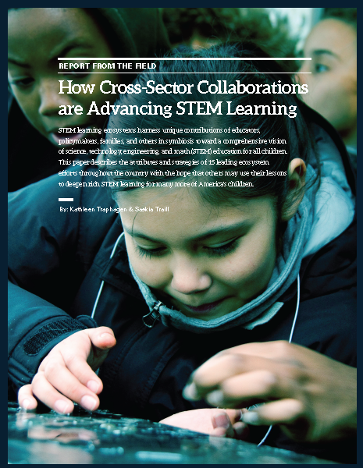
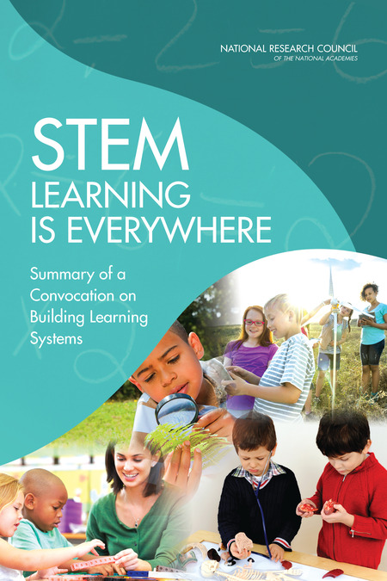

Slide 14
STEM Learning Ecosystems:
A Working Definition
STEM learning ecosystems encompass schools, community settings such as after-school and summer programs, science centers and museums, and informal experiences at home and in a variety of environments.
A learning ecosystem harnesses the unique contributions of all these different settings to deliver STEM learning for all children.

Slide 15
Informal Education
After
School
Education
Formal Education
What opportunities await students and teachers
if the sectors represented by the 3 circles…
Courtesy of Jay Labov, NRC
Notes:
So take for a minute these different worlds of after-school education, run by schools, higher ed, community organizations like Ys or Boys and Girls Clubs, 4H or Ag extension
Look at informal education like the Casper Children’s Science Museum, maybe the national parks.
And formal education—schools and school districts

Slide 16
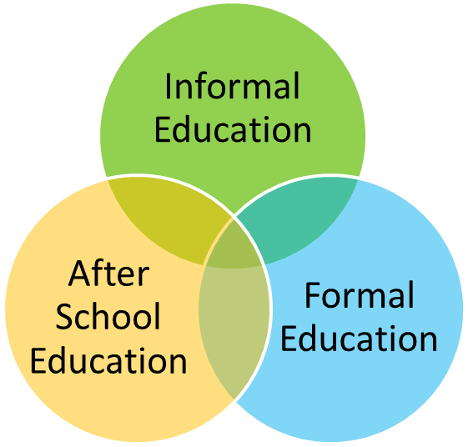
…could be strategically integrated into a Venn Diagram?
Notes:
Now imagine them coming together, to see areas of overlap….

Slide 17
Web & Data System Integration, Extended Learning Experiences, etc
Theme-Based Learning based on the strengths of the informal institution
Examples of Opportunities Between Any 2 of 3 sectors
More time for project based and inquiry based experiential learning and research
Notes:
STEM learning ecosystems have the potential to:
Build children’s scientific practice skills and knowledge through multiple exposures and experiences, including those in which children have the freedom to make and learn from mistakes as part of scientific tinkering and experimentation
Implement creative and diverse methods of assessment, equipping young people with certifications, badges, portfolios or other proof points demonstrating mastery of skills and knowledge that are understood and respected in diverse environments
Theme-based learning--Spark and nurture children’s interest in and enthusiasm for STEM over time, by not only bringing science lessons to life in STEM-rich learning but by connecting environments like museum exhibits, biology labs, recording studios, and marine research vessels, but also exposing children to STEM professionals and a variety of STEM career options

Slide 18
Extension of more seamless student learning opportunities in STEM beyond any sector alone
Clinical Preparation of Pre-Service Teachers
All
Three
Sectors
And
Among
Real-time integration of Cross-Cutting Concepts and Practices in the NGSS & CCSS
Non-traditional opportunities for established teachers
Notes:
STEM learning ecosystems have the potential to:
When you get all three, you:
Enable children’s understanding of cross-cutting concepts to unfold and deepen in intentionally connected ways over time and across settings
Ensure that children build complex skills, including how to exercise their own agency, solve real-world problems, build relationships with adults and
peers, and test out their own leadership and teamwork capabilities as they experience STEM learning connected across different environments
Intentionally support those youth historically under-represented in STEM including girls, linguistic and racial minorities, and economically disadvantaged young people, to foster diverse and inter-connected STEM learning experiences
Increase understanding and build capacity among parents and caregivers to support their children’s learning by ensuring they receive consistent
messaging, guidance and resources from multiple, diverse learning settings

Slide 19
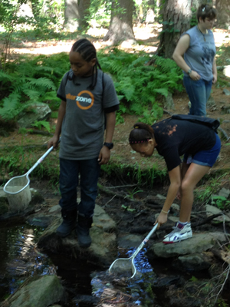
Common Attributes
      Anchored by strong leaders and a collaborative vision and practice
      Attentive to the enlightened self-interest of all partners
      Opportunistic and nimble
Notes:
Hope some of you will leave today resolved to build on these attributes to cultivate ecosystems in your own community.
They are coalitions, but they are typically anchored by strong leaders who have a vision for collaboration and bring other people into or under that vision.
To bring people to the table, they think about what each person needs.
And they are opportunistic and nimble—they follow the money to some extent, and they follow opportunities—if a person they know is at a local glass factory, they develop a curriculum based on glass—in Corning NY, the girl scout troop worked on an entire curriculum on Explosions.

Slide 20
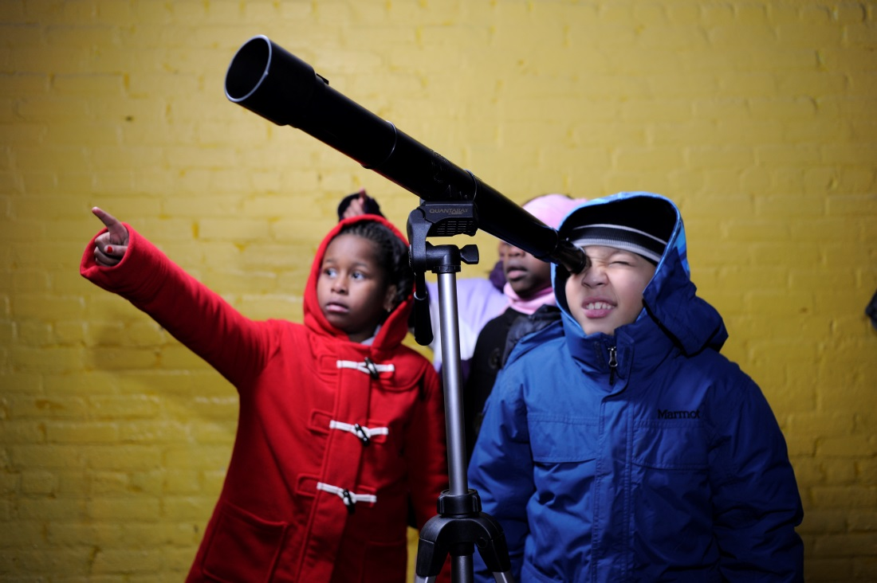
Common Strategies
Building the capacity of educators in all sectors.
Equipping educators from different settings with tools and structures to enable sustained planning and collaboration.
Linking in- and out-of-school STEM learning day-by-day.
Notes:
Common strategies across ecosystems that involve after-school, formal education and STEM-rich institutions

Slide 21
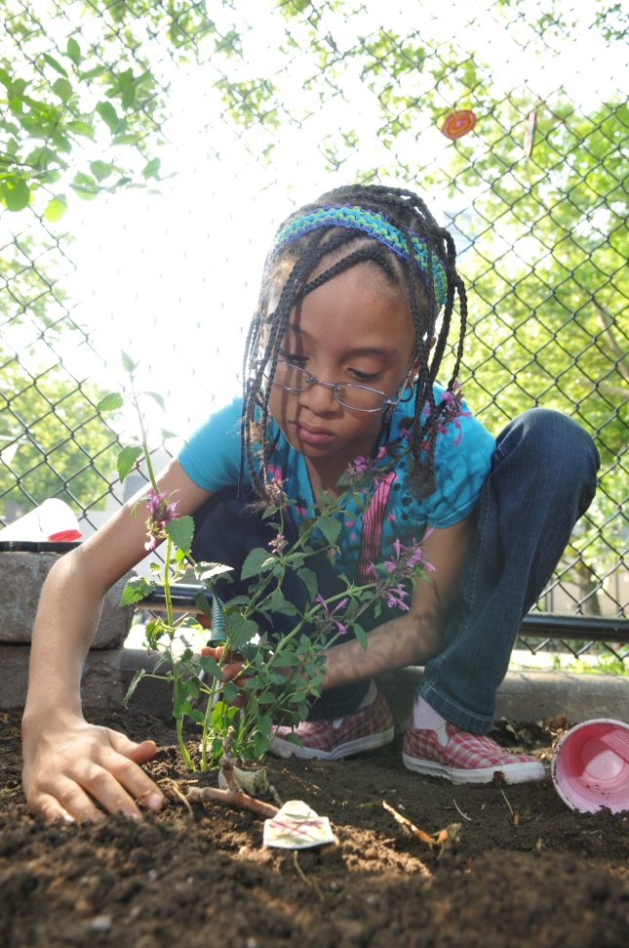
Common Strategies, cont’d
Creating learning progressions for young people that connect and deepen STEM experiences over time.
Focusing curricula and instruction on inquiry, project-based learning and real-world connections to increase relevance for young people.
Engaging families and communities in understanding and supporting children’s STEM success.

Slide 22


Slide 23
Next Steps
STEM Funders Network – Focus areas around Practice, Policy, Research and Communications
Outcomes/Assessment Working Paper, expected early 2015
Practitioners Guide, early 2015
Continued communication and momentum building

Slide 24
Ecosystem Team Activity
With your partner or team members, use the markers and large sticky paper to sketch your ecosystem and place on wall (15 minutes)
Using the index cards on your table, write:
Three strengths of your ecosystem that you can share with others today
Three areas for growth that you want to learn more about today

Slide 25
Table discussions
Share with other teams at your table – explain your ecosystem sketch and share your 3 strengths, 3 areas for growth

Slide 26
Learning Rounds
Each round will last about 30 minutes. Choose two rounds, or stay in one for both, your choice.
Equipping Educators & Changing Instructional Practice
Creating Sequential Learning Opportunities Matched to Young Peoples’ Needs and Interests Over Time
Mapping your Ecosystem
Offering STEM-Rich Learning Environments Across Different Settings
Engaging Family & Community
Convincing Leaders Across Sectors to Cultivate Ecosystems

Slide 27
Data, Assessment and Evaluation Panel
Panelists:
Gabe Lyon, Chicago Architecture Foundation
Larry Plank, Hillsborough County Schools
Hillary Salmons, Providence After School Alliance
Moderator: Elizabeth Devaney, American Institutes for Research

Slide 28
Sector-Based Working Groups
Please join your peers to raise issues particular to your own sector
Schools and School Districts
Science Expert Institutions
Intermediary Organizations
Place-Based Initiatives

Slide 29
What issues from other sectors resonate with you?
Place your 10 sticky dots next to issues that came up in the discussions of other sectors that resonate most for you

Slide 30
Scale, Depth and Sustainability Panel
Panelists:
Jeremy Eltz, Indiana Department of Education
CynDee Zandes, Think Together and Orange County STEM Initiative
Molly Demeulenaere, Museum of Science and Industry, Tampa
Moderator: Sue Allen, Maine Mathematics and Science Alliance

Slide 31

End of Day Reflection
Please use index cards to write:
Key points of day that would be useful in Guide
What kinds of formats would you actually use and what do you think your peers would use?
Interested in continuing the conversation?
And how/with who/about what/what format

Slide 32
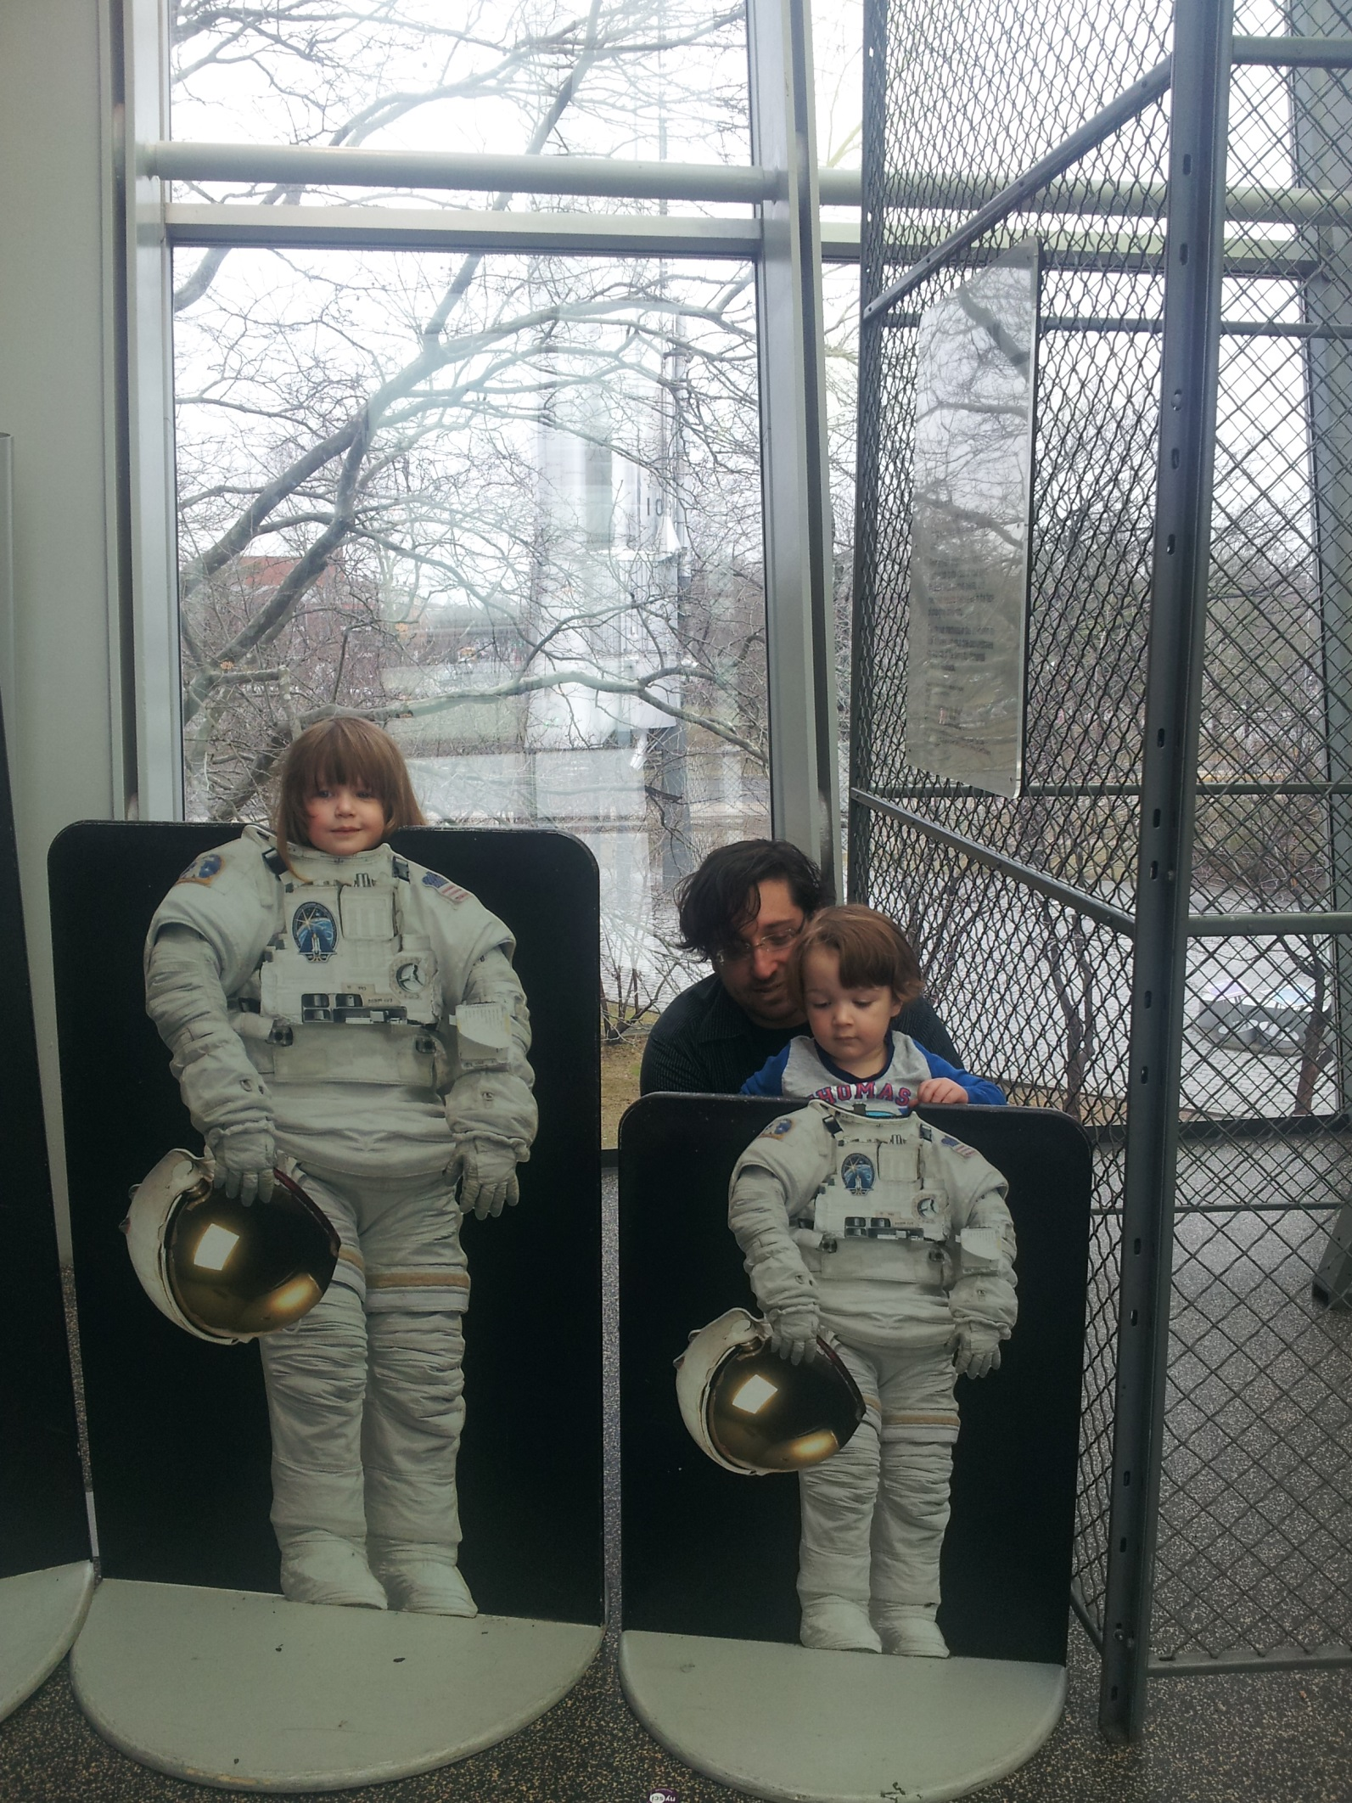
Thank you and travel safely home!
Saskia Traill
Vice-President, Policy and Research
straill@expandedschools.org
(646) 943-8757
Kathleen Traphagen
Project Team
STEM Funders Network and STEM Learning Ecosystems
Kathleentrap@yahoo.com
(413) 687-1710

